Slide 1



DISASTER MANAGEMENT SYSTEM
FLAMINGOS

Slide 2
CCOLLABORATORS
1.MUGISHA Leopold 26636
2.HIRWA Ines 25870
3.MUGENI Raissa 25880
4.NDAGIJIMANA Aime 26315
5.IGIHOZO Elyse 26881
6.NKUSI William 22980
7.UWIZEYE Magnifique 26676
8.MANZI Ezra 26688
9.TETA Anny Stella 26250
10.NYARWAYA GISABO Gadiella 26519

Slide 4
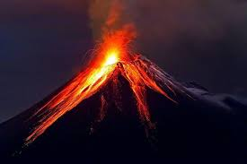
01
02
03
INTRODUCTION
PROBLEM STATEMENT
ADVANCED PROGRAMMING
OVERVIEW
04
05
06
APPROACH AND TECHNOLOGIES
CHALLENGES FACED
PLANNED IMPROVEMENTS
07
08
CONCLUSION
REFERENCES

Slide 5
01
INTRODUCTION
In 2023, severe flooding in Rubavu district, Rwanda, led to extensive infrastructure damage and displacement of residents. The floods disrupted critical infrastructure, isolating communities and complicating relief efforts. Communication among response teams was fragmented, resulting in delayed resource distribution and overcrowded shelters.
A centralized disaster management system could have significantly improved the response by providing real-time data, streamlining resource allocation, coordinating volunteer efforts, and tracking shelter capacities. This system would ensure more efficient and timely aid, minimizing delays and optimizing support for those affected .

Slide 6
OBJECTIVES
Develop a centralized database to manage and store critical information on disasters, resources, response teams, shelters, affected areas, victims, and reports.
Enhance the speed and efficiency of disaster response through centralized access to real-time data
Enable effective tracking and allocation of resources, personnel assignments, shelter occupancy, and support needs for affected individuals.

Slide 7
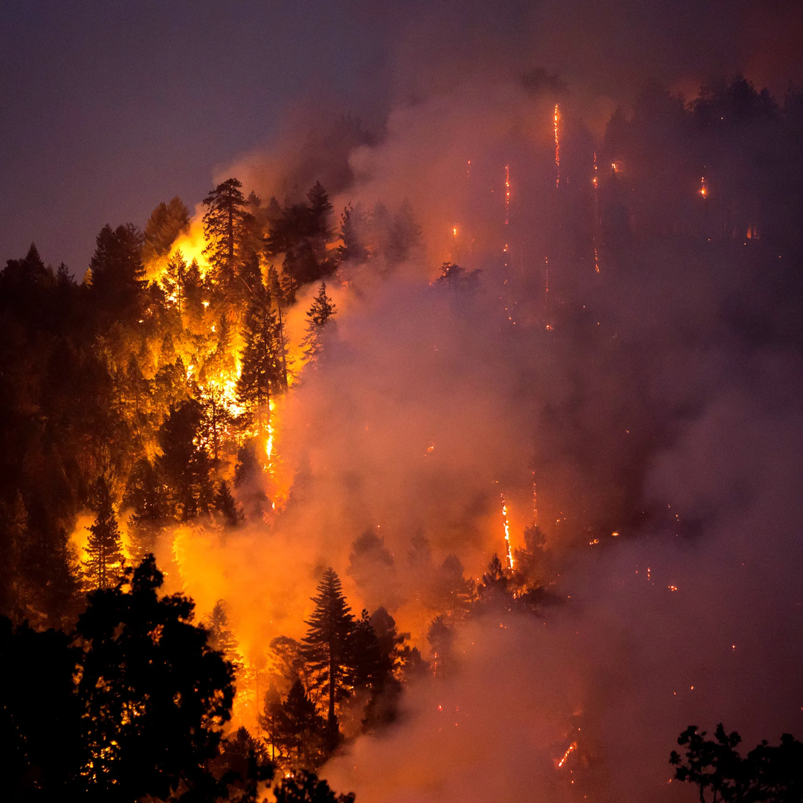
02
PROBLEM STATEMENT
Problem: Disaster response operations encounter substantial hurdles due to inaccurate information and a lack of timely updates on available resources, shelters, staff, victims, and ongoing support actions. These gaps can cause delays, ineffective resource allocation, and challenges in providing timely assistance to individuals affected.
Solution: A centralized database system for disaster management that assembles data on catastrophic events occurrences, available resources, response teams, shelters, regions impacted, victims, and daily reports. Through the facilitation of coordinated decision-making and the optimization of personnel and resource allocation, this system will increase response efficiency.

Slide 8
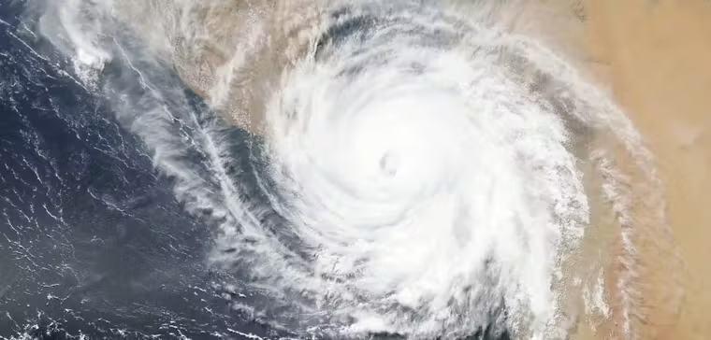
03
ADVANCED PROGRAMMING
Why Advanced Techniques?:
1.Triggers: Automate tasks like updating shelter occupancy and logging changes.
2.Cursors: Handle dynamic, row-by-row operations like allocating resources based on population.
3.Packages: Organize reusable procedures for better scalability and modularity.
4.Auditing: Track sensitive data changes and ensure accountability.

Slide 9
1.Triggers : is a stored procedure in a database that automatically executes (or "fires") in response to certain events, such as INSERT, UPDATE, or DELETE operations on a table , eg; before and after triggers.
2.Cursors:A cursor is a database object used to process rows returned by a query one at a time. It is especially useful for row-by-row operations where bulk processing is not feasible eg implicit and explicit.
3. Attributes:(%TYPE and %ROWTYPE)
%TYPE: Refers to the data type of a column in a table, ensuring consistency between variables and table structures.
%ROWTYPE: Represents the entire structure of a table row, allowing you to handle all columns as a single record.
4. Functions: function is a PL/SQL program that performs a specific task and returns a single value. Functions encapsulate reusable logic to streamline operations.
5.Procedures:A procedure is a PL/SQL program that performs a set of operations but does not return a value. Procedures are often used for tasks like updates, deletions, or complex workflows.
6.Auditing:Auditing is the process of tracking and monitoring database activity, often to enhance security and accountability. It involves:
-Logging user actions (e.g., changes to sensitive data).
-Tracking operations like INSERT, UPDATE, and DELETE.

Slide 10
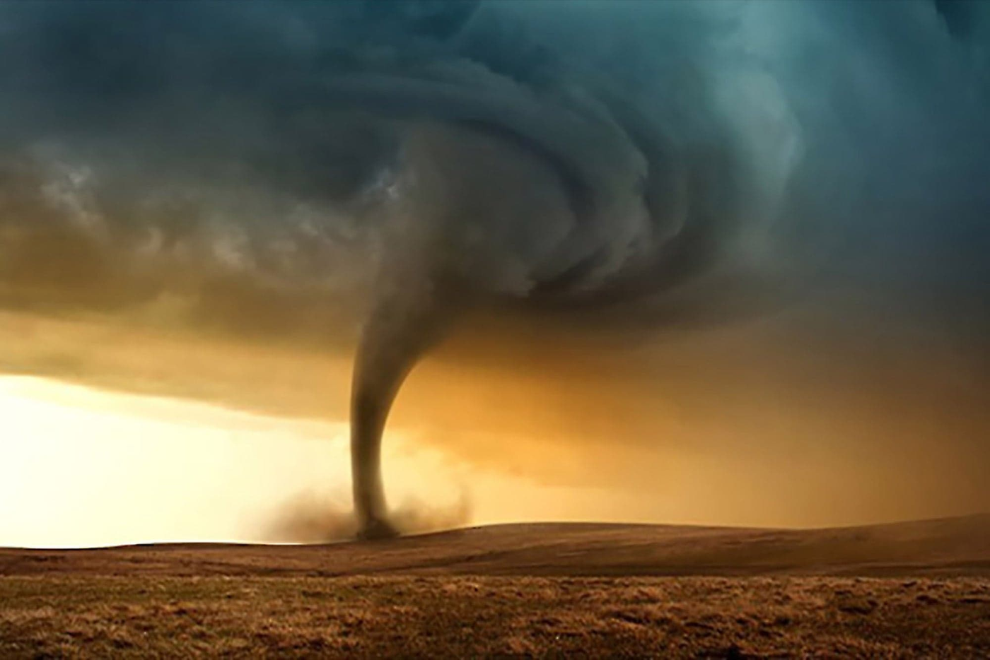
Approach:
1.Designed a logical and physical database model.
2.Created and populated tables for disasters, resources, victims, and shelters.
3.Implemented triggers for automation, cursors for dynamic operations, and auditing mechanisms for security.
4.Used packages and functions for modular coding.
04
APPROACH AND TECHNOLOGIES

Slide 11
Technologies and Tools:
1.Database: Oracle PL/SQL
2.Programming Language: SQL, PL/SQL
3.Tools: SQL Developer, Oracle Enterprise Manager (OEM)
Version Control: GitHub
4.Methods: Entity-Relationship Modeling, Advanced PL/SQL
Programming

Slide 12
TRIGGERS :
CREATE OR REPLACE TRIGGER enforce_shelter_capacity BEFORE INSERT OR UPDATE ON victims FOR EACH ROW
DECLARE
shelter_capacity NUMBER; current_occupancy NUMBER;
BEGIN
SELECT capacity, current_occupancy INTO shelter_capacity, current_occupancy FROM shelter WHERE shelter_id = :NEW.shelter_id;
IF current_occupancy >= shelter_capacity
THEN RAISE_APPLICATION_ERROR(-20001, 'Shelter capacity exceeded!');
END IF;
UPDATE shelter SET current_occupancy = current_occupancy + 1 WHERE shelter_id = :NEW.shelter_id;
END;
/

Slide 13
CURSORS :
CREATE OR REPLACE PROCEDURE allocate_resources_by_priority IS CURSOR resource_cursor IS
SELECT resource_id, type FROM resources WHERE allocation_status = 'PENDING' ORDER BY type;
CURSOR disaster_cursor IS
SELECT disaster_id, impact_level FROM disaster ORDER BY impact_level DESC;
res resource_cursor%ROWTYPE;
dis disaster_cursor%ROWTYPE;
BEGIN
OPEN resource_cursor;
OPEN disaster_cursor;
LOOP
FETCH resource_cursor INTO res;
FETCH disaster_cursor INTO dis;
EXIT WHEN resource_cursor%NOTFOUND OR disaster_cursor%NOTFOUND;
UPDATE resources
SET allocation_status = 'ALLOCATED', assigned_area_id = dis.disaster_id WHERE resource_id = res.resource_id;
END LOOP;
CLOSE resource_cursor;
CLOSE disaster_cursor;
COMMIT;
END;
\

Slide 14
FUNCTIONS :
CREATE OR REPLACE FUNCTION get_available_capacity(shelter_id IN NUMBER)
RETURN NUMBER
IS
available_capacity NUMBER;
BEGIN
SELECT (capacity - current_occupancy)INTO available_capacity
FROM shelter
WHERE shelter_id = shelter_id;
RETURN available_capacity;
END;
/
PROCEDURES
CREATE OR REPLACE PROCEDURE assign_resources(disaster_id IN NUMBER, resource_id IN NUMBER) IS
BEGIN
UPDATE resources
SET assigned_area_id = (
SELECT affected_areas_id FROM disaster WHERE disaster_id = disaster_id
), allocation_status = 'ALLOCATED'
WHERE resource_id = resource_id;
COMMIT;
END;
/

Slide 15
AUDITING:
CREATE TABLE audit_log (
log_id NUMBER PRIMARY KEY,
table_name VARCHAR2(50),
action VARCHAR2(10),
timestamp DATE,
user_name VARCHAR2(50),
details CLOB
);
PACKAGES
A package in PL/SQL is a schema object that groups logically related procedures, functions, variables, cursors, and other PL/SQL elements into a single unit. It acts as a container for these objects, promoting better organization, reusability, and security in PL/SQL programming

Slide 16
Steps Followed in Project Development
1.Problem Identification: Defined challenges in disaster management, such as manual workflows and data fragmentation.
2.Database Design: Developed a logical and physical database model, including tables for disasters, resources, victims, and shelters.
3.Database Implementation: Created and populated tables, establishing relationships and applying constraints.
4.Advanced Programming: Implemented triggers for automation, cursors for row-by-row processing, functions for reusable logic, and packages for modularity.
5.Auditing Mechanisms: Set up tracking and restriction features to monitor sensitive data changes and enforce accountability.
6.Testing and Optimization: Validated workflows, data integrity, and security mechanisms through extensive testing.
7.Documentation: Recorded the design, implementation, and testing processes for reporting and presentation.

Slide 17
CHALLENGES FACED
05
1.Reserved Keywords: Conflicts with reserved column names like Date required renaming to avoid errors.
2.Complex Trigger Logic: Designing compound triggers for multi-row operations needed careful testing for transactional consistency.
3.Data Integrity Issues: Ensuring accurate updates with constraints and auditing mechanisms.
4.OEM Configuration: Troubleshooting listener issues and registering the database in Oracle Enterprise Manager.

Slide 18


06
PLANNED IMPROVEMENTS
1.Enhance the reporting module for real-time analytics on disaster response.
2.Develop a web-based user interface for easier data interaction.
3.Integrate machine learning to predict resource needs based on past disasters.
4.Implement geospatial tracking for more precise resource deployment.

Slide 19
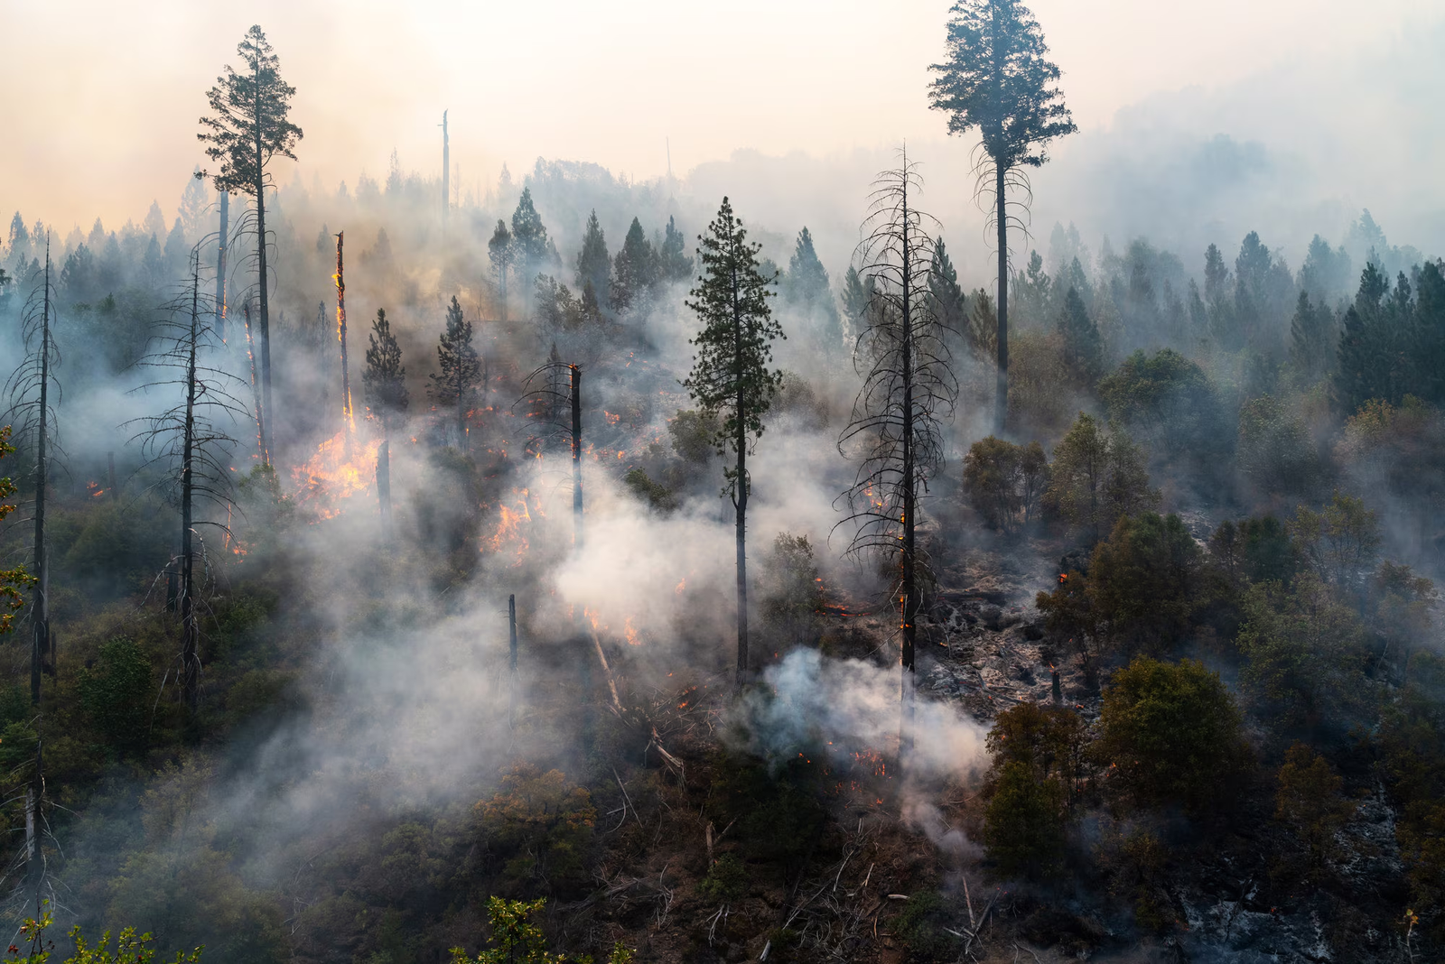
07
CONCLUSION
The Disaster Management System effectively streamlines resource allocation, victim tracking, and shelter management using advanced PL/SQL techniques. The project demonstrates the significance of automation, modularity, and security in real-world database systems.
Learnings:
Gained hands-on experience with PL/SQL features like triggers, cursors, and packages.
Understood the importance of auditing for accountability and security.
Significance:
This system provides a scalable and secure solution for disaster response coordination, addressing critical real-world challenges.

Slide 20
REFERENCES
08
Tools and Platforms:
1.Oracle Database 19c
2.SQL Developer
3.Oracle Enterprise Manager (OEM)
4.GitHub for version control
5.Documentation and Tutorials:
Oracle Documentation: https://docs.oracle.com
6.SQL and PL/SQL Tutorials: W3Schools
7.PL/SQL Triggers and Packages: GeeksforGeeks
Project Requirements:
Provided guidelines and resources
Other Sources:
Research articles on disaster management systems and database security best practices.

Slide 21

THANK YOU

